Slide 1

WORKSHOP
DESIGN THINKING FROM RESEARCH TO PRODUCT

Slide 2


Slide 3
1. The Drive to Acquire.
Feature 1
2. The Drive to Bond.
Feature 2
3. The Drive to Learn
4. The Drive to Defend
5. The Drive to Feel.
Notes:
four Core Human Drives that have a profound influence on our decisions and actions: 1. The Drive to Acquire. The desire to obtain or collect physical objects, as well as immaterial qualities like status, power, and influence. Businesses built on the drive to acquire include retailers, investment brokerages, and political consulting companies. Companies that promise to make us wealthy, famous, influential, or powerful connect to this drive. 2. The Drive to Bond. The desire to feel valued and loved by forming relationships with others, either platonic or romantic. Businesses built on the drive to bond include restaurants, conferences, and dating services. Companies that promise to make us attractive, well liked, or highly regarded connect to this drive. 3. The Drive to Learn. The desire to satisfy our curiosity. Businesses built on the drive to learn include academic programs, book publishers, and training workshops. Companies that promise to make us more knowledgeable or competent connect to this drive.
4. The Drive to Defend. The desire to protect ourselves, our loved ones, and our property. Businesses built on the drive to defend include home alarm systems, insurance products, martial arts training, and legal services. Companies that promise to keep us safe, eliminate a problem, or prevent bad things from happening connect to this drive. There’s a fifth core drive that Lawrence and Nohria missed: 5. The Drive to Feel. The desire for new sensory stimulus, intense emotional experiences, pleasure, excitement, entertainment, and anticipation. Businesses built on the drive to feel include restaurants, movies, games, concerts, and sporting events. Offers that promise to give us pleasure, thrill us, or give us something to look forward to connect with this drive.

Slide 4
How to know what people want?

Slide 6
DESIGN THINKING

Slide 7
DESIGN THINKING

Slide 8

DESIGN THINKING

Slide 9
How to explore design thinking?

Slide 10
DESIGN THINKING PROCESS

Slide 11
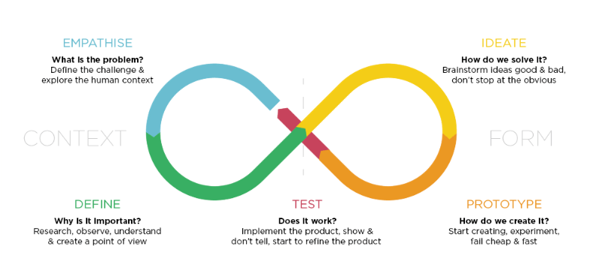
DESIGN THINKING PROCESS

Slide 12

DESIGN THINKING PROCESS

Slide 13
Design Thinking
Challenge

Slide 14
ACTIVITY TRACKER CHALLENGE
Help to reach your health goals?
Learn if you are active enough?
How did you sleep?
Track a disease?
Share your runs with friends?
A smartwatch? A t-shirt? A hat? Underpants? An implant?

Slide 15
ACTIVITY TRACKER CHALLENGE
The Activity Tracker Project is a very quick
overview of the entire design thinking process.
In 40min we ask to:
Interview your partner to gain insights about his/her wants and needs
Define a point of view based on the insights they found
Sketch some new alternatives based on the point of view
Test these new ideas with their partner to gather feedback
Act on the feedback and build a prototype of an Activity Tracker

Slide 16
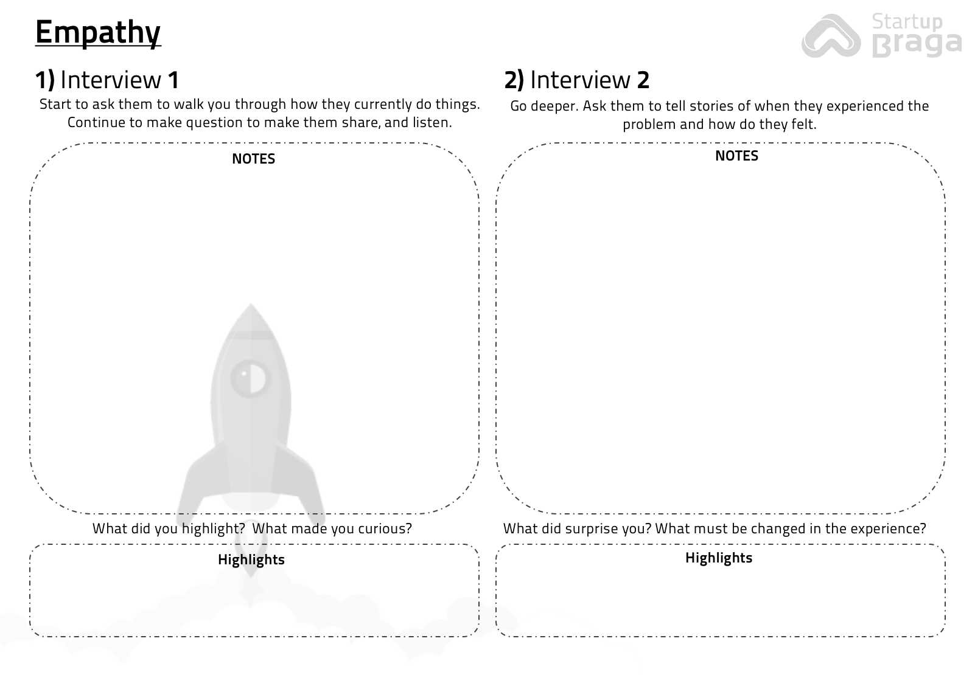

ACTIVITY TRACKER CHALLENGE
3 minutes
Interview 1 – Person 1
In Pairs
End

Slide 17
ACTIVITY TRACKER CHALLENGE
3 minutes
Interview 1 – Person 2
In Pairs
End

Slide 18
ACTIVITY TRACKER CHALLENGE
3 minutes
Interview 2 – Person 1
In Pairs
End

Slide 19
ACTIVITY TRACKER CHALLENGE
3 minutes
Interview 2 – Person 2
In Pairs
End

Slide 20
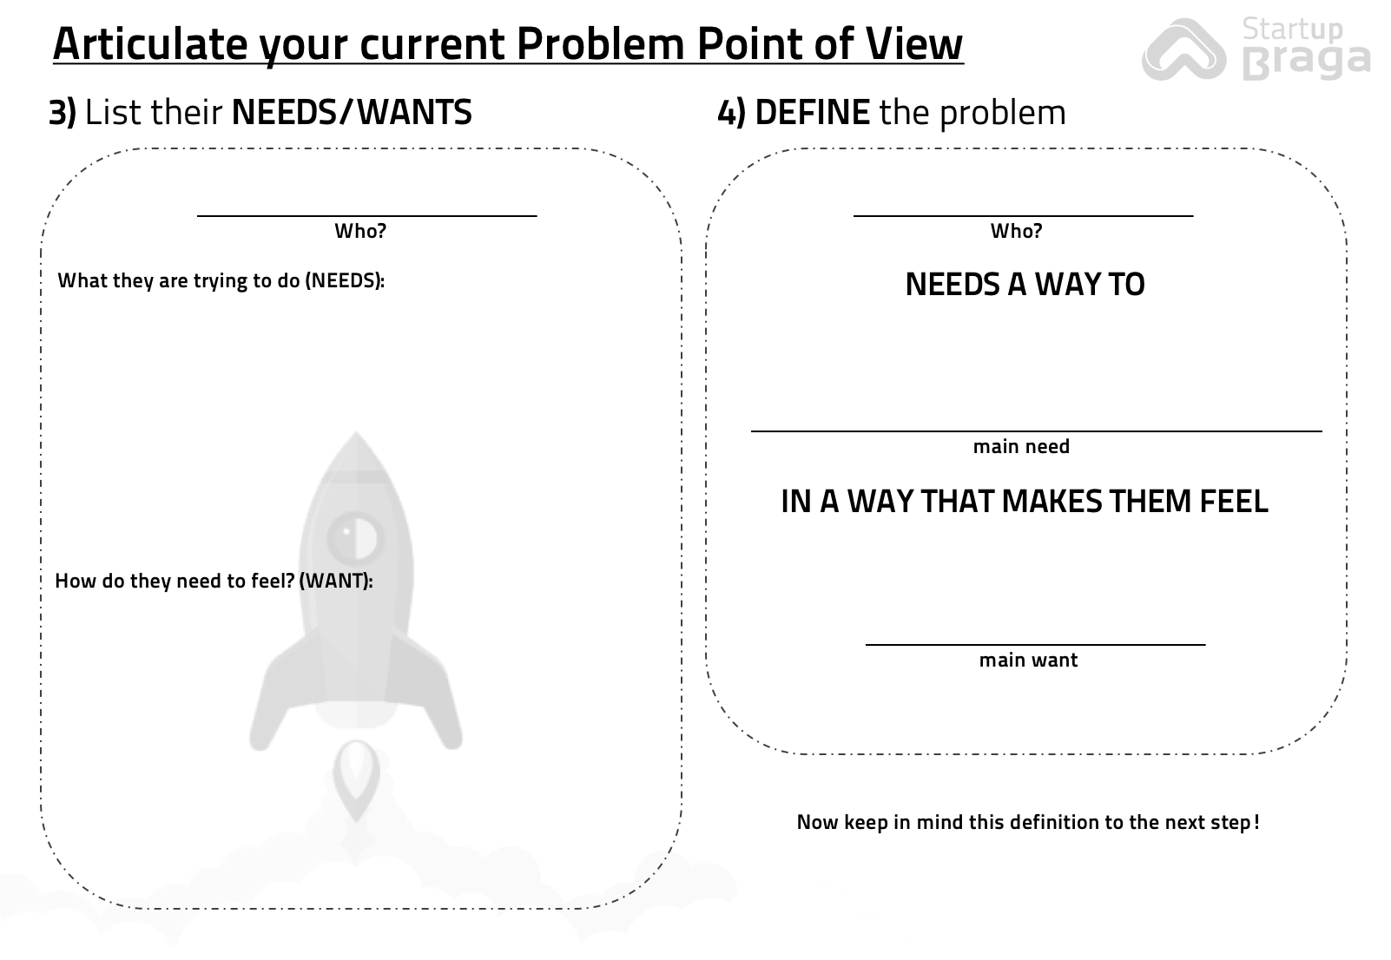
ACTIVITY TRACKER CHALLENGE
3 minutes
Define Needs + the Problem
Individually
End

Slide 21
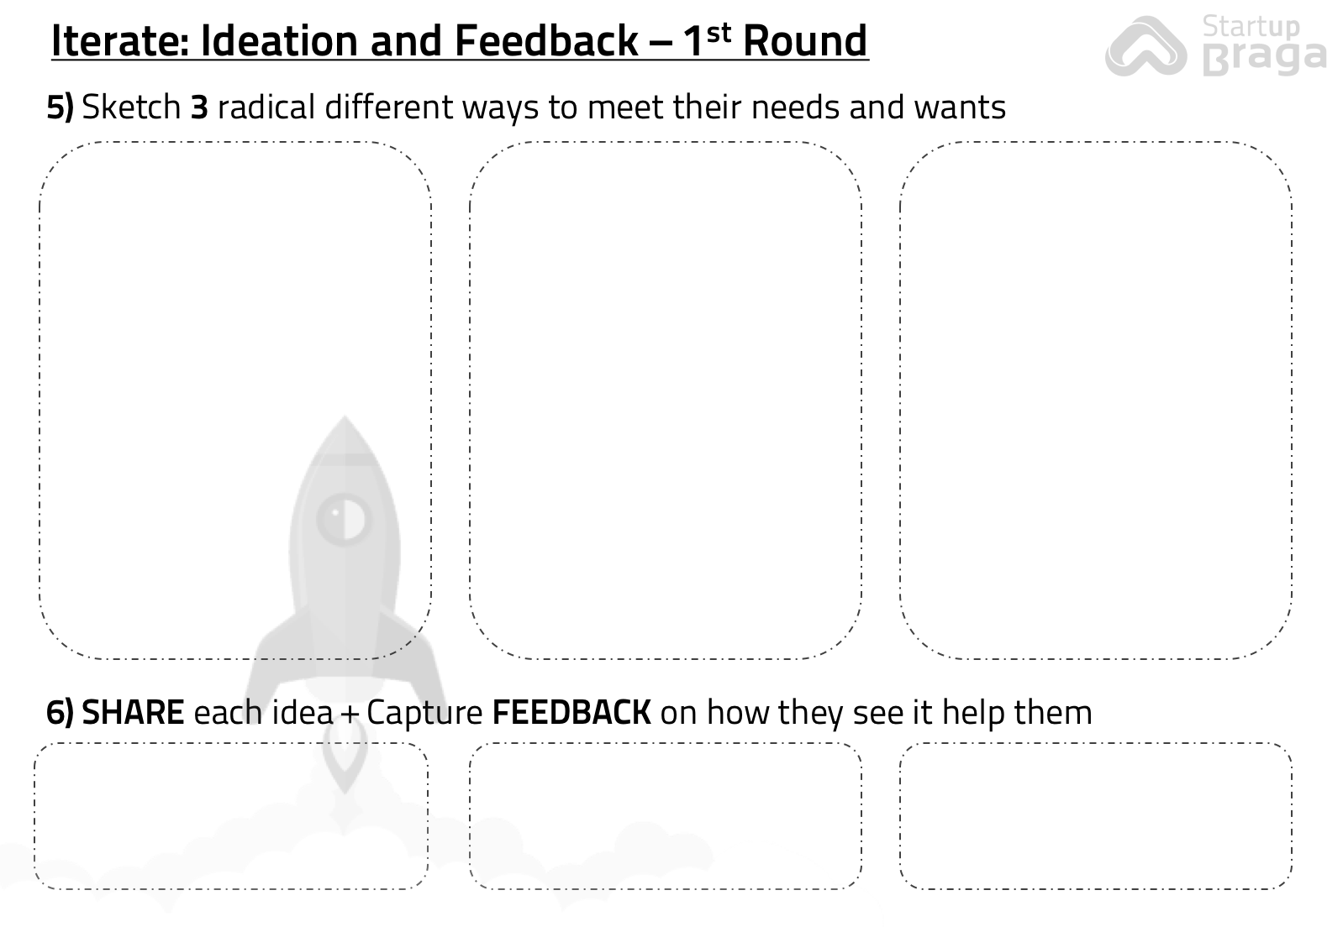
ACTIVITY TRACKER CHALLENGE
10 minutes
Sketch some ideas
Individually
End

Slide 22
ACTIVITY TRACKER CHALLENGE
4 minutes
Get Feedback – Person 1
In Pairs
End

Slide 23
ACTIVITY TRACKER CHALLENGE
4 minutes
Get Feedback – Person 2
In Pairs
End

Slide 24
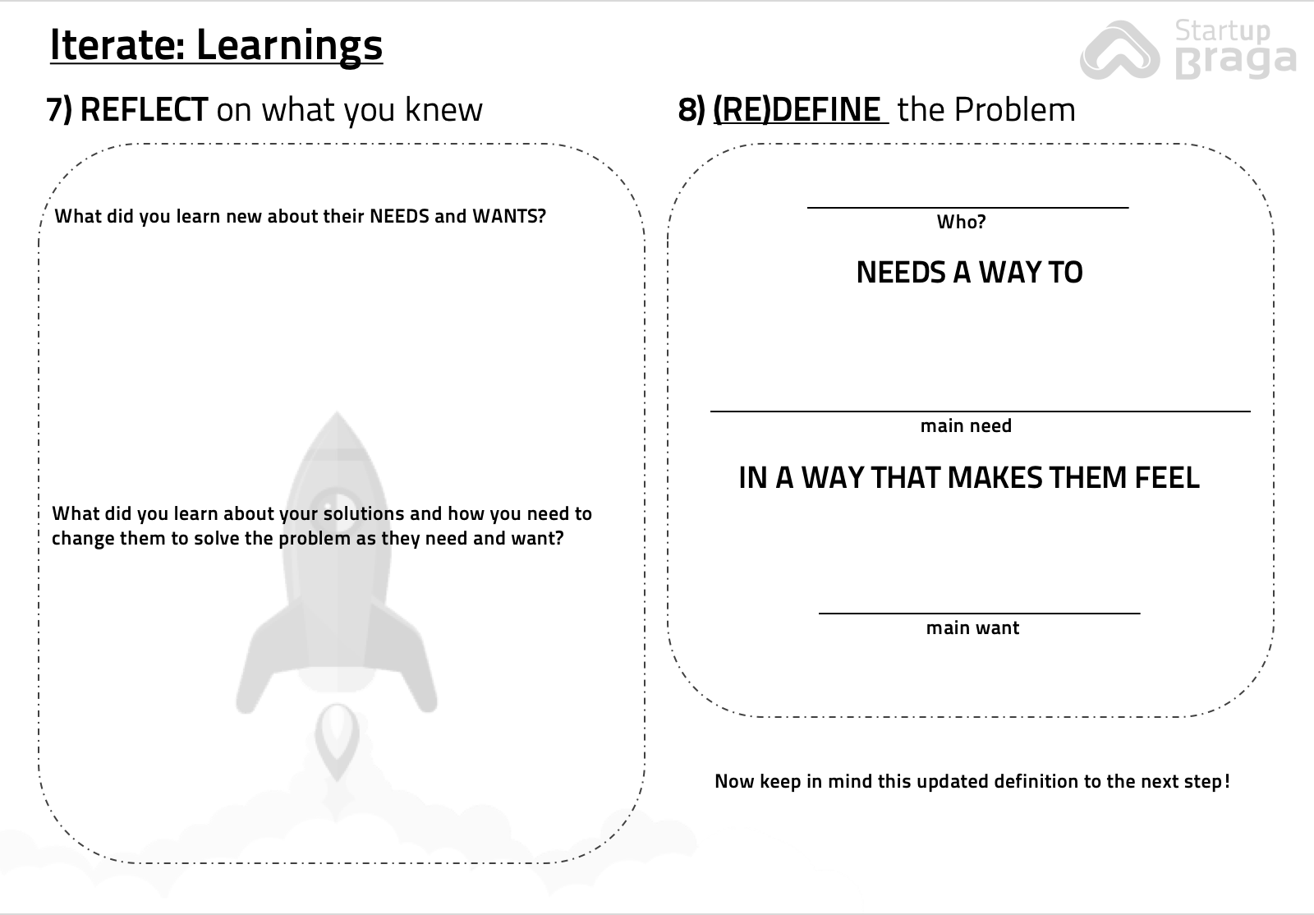
ACTIVITY TRACKER CHALLENGE
3 minutes
Review Problem Definition
Individually
End

Slide 25
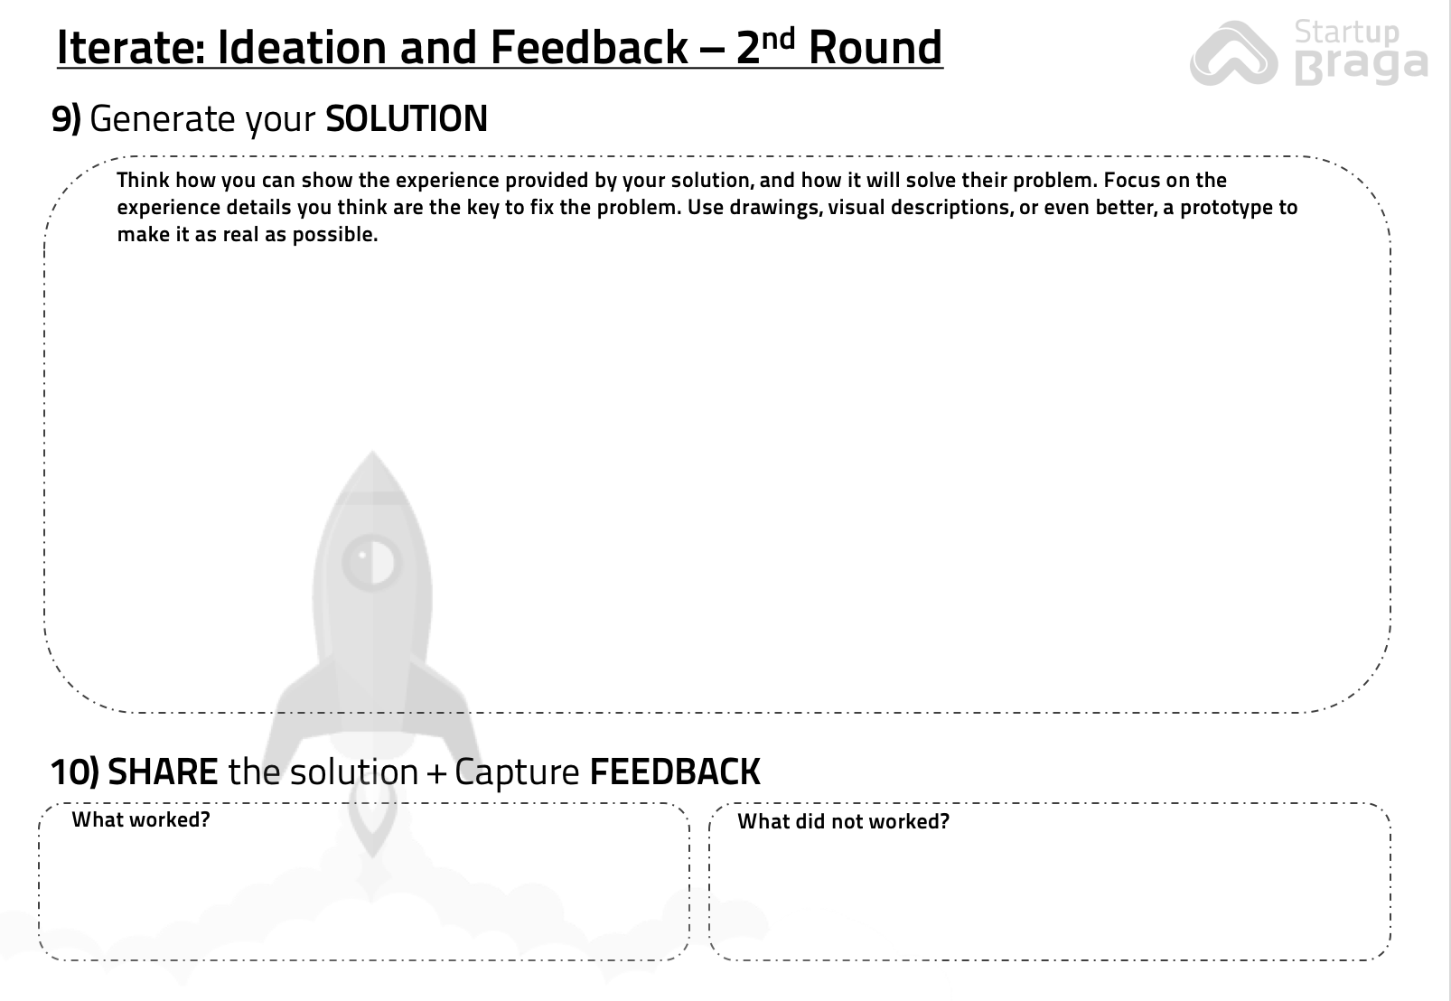
ACTIVITY TRACKER CHALLENGE
5 minutes
Create your Solution
Individually
End

Slide 26
ACTIVITY TRACKER CHALLENGE
3 minutes
Get Feedback – Person 1
In Pairs
End

Slide 27
ACTIVITY TRACKER CHALLENGE
3 minutes
Get Feedback – Person 2
In Pairs
End

Slide 28
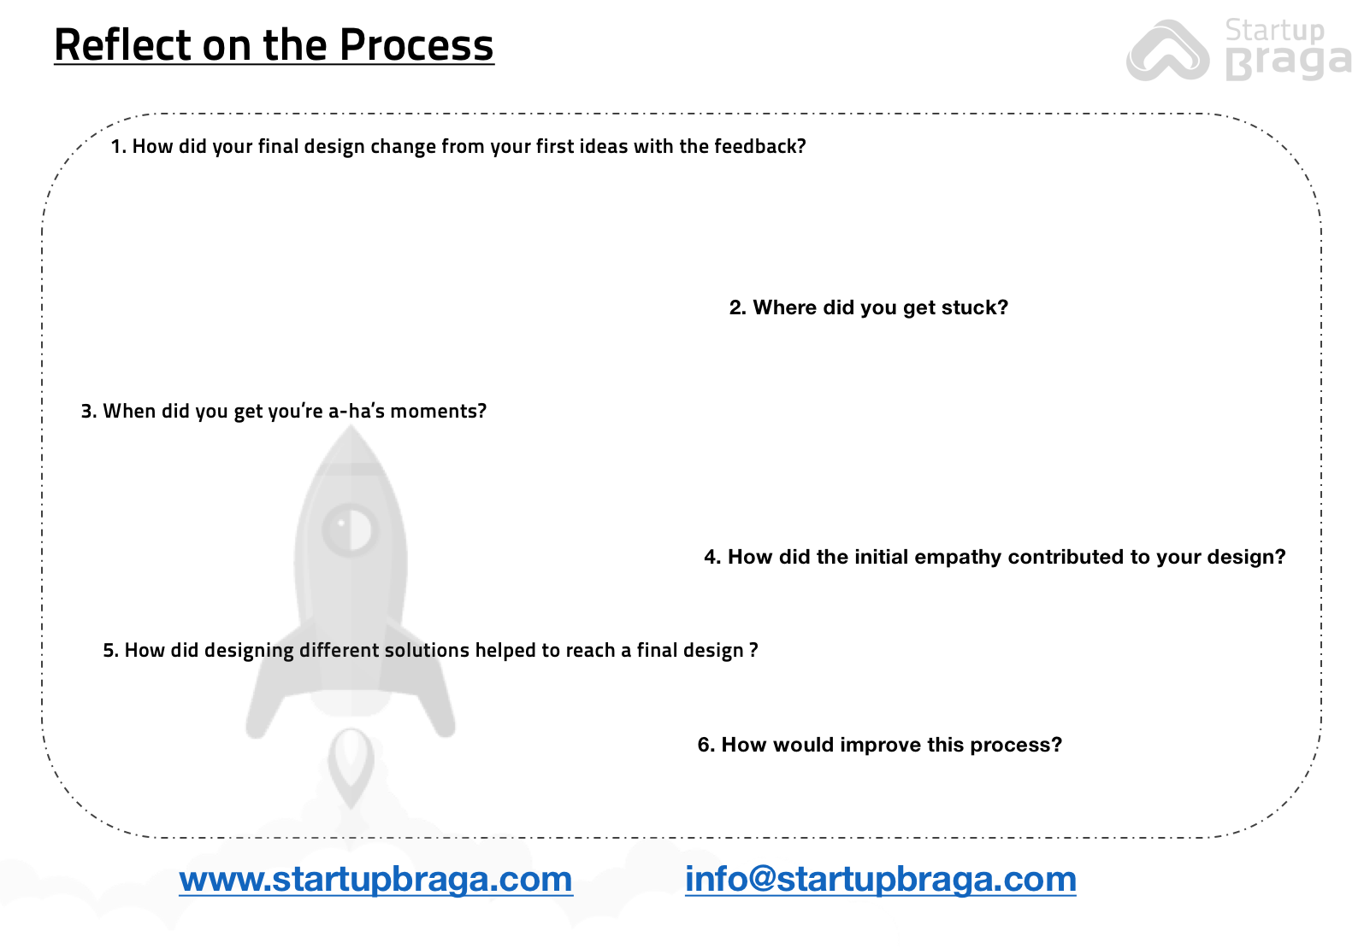
ACTIVITY TRACKER CHALLENGE
Congratulations!
Now continue learning, thinking and iterating!

Slide 29

Startup Braga is an initiative from InvestBraga - Agency for Economic Development.

